Slide 1
Understand React Structure

Slide 2
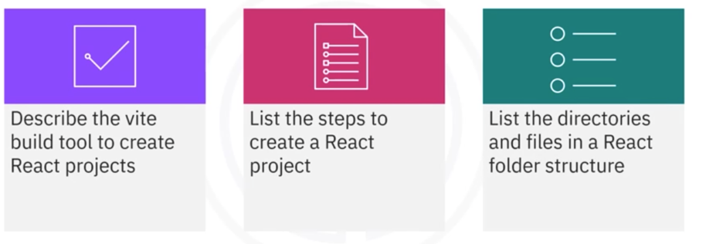
What you will learn

Slide 3
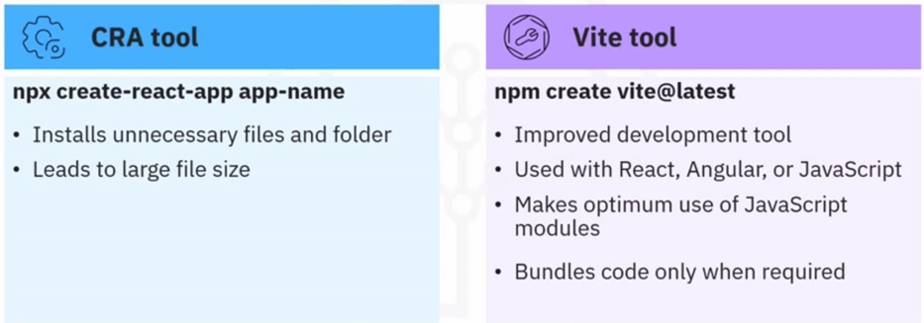
Introduction to build tools

Slide 4
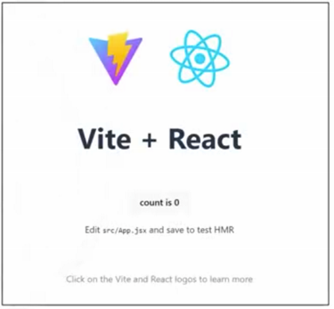
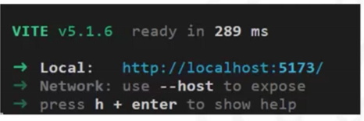
Creating React project

Slide 5
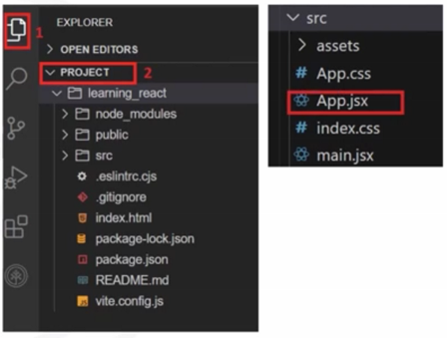
React folder structure
• Node_modules: Dependencies
through npm and yarn
• public: Static assets like HTML
files, images, and fonts
• src: Source code for the React
application
• main . jsx: Entry point for the
React application
• App. jsx: Root component of the
React application

Slide 6
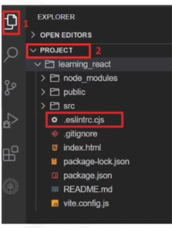
React folder structure
• package. json: Metadata, scripts
for running, building, and testing
• Vite . config. js: Configuration
settings for the Vite build tool
• .gitignore: Files and directories to
be ignored
• README. md file: Setup
instructions, usage guidelines, and
project documentation
• Index. html: Entry point for web
applications
• eslintrc . cjs: Configuration file
used by ESLint

Slide 7
Recap
In this video, you learned that:
• Vite is a build tool which is an improved development tool for front-end
projects in the current web development scenario
• Vite handles JavaScript modules by bundling code only when its required,
which speeds up time for programming and building
• After creating a React project with Vite, the folder structure consists of
many directories and files like node modules, public, src, main. jsx ,
App. jsx, package. j son, and so on

